Slide 1
The 8 T’s of Grateful Living
POWERPOINT SLIDES INSTRUCTIONS
(Delete this slide before presenting! ☺)
Check this out.
All the work is done! ☺
These slides are simply a helpful guide to get you started on the 8 T’s of Grateful Living theme. You can add, delete or edit them to suit your personal message.
To insert a New Slide. Select New Slide or Layout and select from the 25 x slide templates.* Then simply insert your own text and images onto the slides.
*If you would like to edit the 25 Master templates or make additional slide templates you will need to do the following: Select View > Master > Slide Master.
You can then duplicate a slide layout and make the changes you want.
When you're done, simply select Close Master View.

Slide 2
Why should we encourage Grateful Living? (Delete this slide before presenting! ☺)
This series of Grateful Living messages falls under the category of what we often call ‘stewardship’—managing the things that God gives us—but for many listeners these messages will open up a whole new way of living abundantly (John 10:10).
You see, it’s simple, yet profound. God is love, and because he loves he gives (see John 3:16). God calls us to be faithful stewards of His love by loving Him and giving His love to others. We do this by sharing all that we have and are.
The very heart and foundation of stewardship isn’t money, it’s love.
At it’s very essence, Faithful Stewardship = Loving God and people with all we have and are. We are to love God and people with everything, with our 8 T’s—Time, Talents Testimony, Temple, Treasure, Territory, Tribe and God’s Truth.
In the book Counsels on Stewardship by Ellen G. White, the word ‘love’ is used 36 times in just the first 18 pages! Love is the foundation of stewardship.
When we understand God’s love we live gratefully. Grateful Living is about whole-of-life giving. It’s about passing on the things that our loving Provider God gives to us. God gives, so that we can give. “And God is able to make all grace abound to you, so that in all things at all times having all that you need you will abound in every good work.” (2 Corinthians 9:8)
The gospel calls for a whole new way of living, grateful living, and it places love at the centre—not money, investments, security, prestige or comfort. When we love like God loves, “when we love the world as He has loved it, then for us His mission is accomplished. We are fitted for heaven; for we have heaven in our hearts.” (Ellen G. White, The Desire of Ages, p. 641)
So is this 8 Pillars of Grateful Living really a stewardship series? Yes, because grateful living leads to cheerful giving, not only more faithful tithes and generous, systematic offerings, but whole-of-life giving, and that’s what God invites us to experience.
Welcome! to a whole new level of Christ-centred abundant living.

Slide 3
Grateful Living Topic: TEMPLE
Message Overview (Delete this slide before presenting! ☺)
Key Scriptures: 1 Corinthians 3:16-17; 3 John 1:2; Luke 2:52
Key EGW Writings: Christ’s Object Lessons, pp. 346-348
Goal: Caring for my mind & body for God’s service.
Interview Idea: Is there an inspiring person in your church or wider community who you can interview (maybe even by phone or Zoom) about glorifying God through caring for their body temple (physical, mental and spiritual health)?

Slide 4
The slides for the actual presentation start on slide #5.
(Delete this slide before presenting! ☺)

Slide 6
The 2-minute video called
Grateful Living Overview & Introduction - Low Res
can be inserted here.

Slide 11

The Great Controversy
^
God’s Blueprint
Satan’s Counterfeit
God created me and He knows what’s best for my health and peace.
My body is God’s temple, and I am committed to using it for His glory.
By protecting my physical temple, I am helping my mental and spiritual health.
God wants to bless me with a long, healthy, satisfying life.
I will protect my eyes, ears and mouth from things that will defile God’s temple.
My body is mine, so I can use it how I want. ‘My body my choice.’
God’s diet for my eyes, ears and mouth is old-fashioned and boring.
Poor health is just a matter of random chance, so I can live however I want.
I will eat, drink and be merry today, and maybe decide to live better tomorrow.
There’s no relationship between diet and spirituality.

Slide 12
Beloved, I pray that you may prosper in all things and be in health, just as your soul prospers.
3 John 1:2 (NKJV)

Slide 13
Do you not know that you are the temple of God and that the Spirit of God dwells in you? If anyone defiles the temple of God, God will destroy him. For the temple of God is holy, which temple you are.
1 Corinthians 3:16-17 (NKJV)

Slide 14
And Jesus increased in wisdom and stature, and in favour with God and men.
Luke 2:52 (NKJV)

Slide 15
And Jesus increased in wisdom [mental] and stature [physical], and in favour with God [spiritual] and men [social].
Luke 2:52 (NKJV)

Slide 16
Today we’ll focus on being faithful stewards of our temple’s PHYSICAL and MENTAL health

Slide 17

“The relation of the physical organism to the spiritual life is one of the most important branches of education.”
Ellen G. White, Christ’s Object Lessons, 348

Slide 18
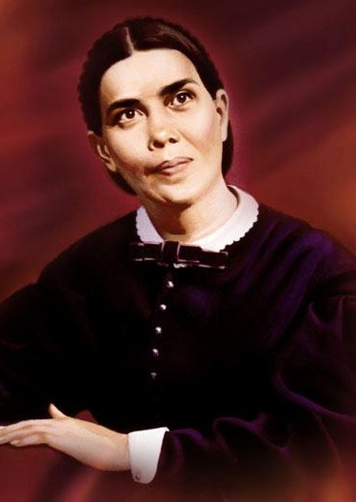
“I proclaimed health reform everywhere I went. … I proclaimed the message of temperance in eating, drinking, and dressing. … There were those in attendance at our camp meetings who ate and drank improperly. Their diet was not in harmony with the light God had given, and it was impossible for them to appreciate the truth in its sacred, holy bearing.”
Ellen G. White, Counsels on Health, 531-2

Slide 19
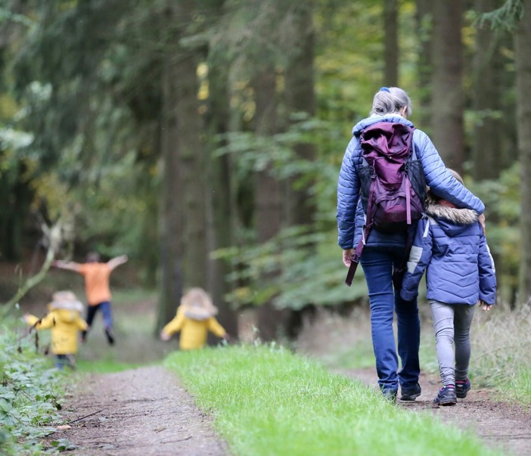
“Health is a blessing of which few appreciate the value; yet upon it the efficiency of our mental and physical powers largely depends. Our impulses and passions have their seat in the body, and it must be kept in the best condition physically and under the most spiritual influences in order that our talents may be put to the highest use.”
Ellen G. White, Christ’s Object Lessons, 346

Slide 20

“God places a high estimate on those who do faithful service in preparing wholesome, palatable food. The one who understands the art of properly preparing food, and who uses this knowledge, is worthy of higher commendation than those engaged in any other line of work. This talent should be regarded as equal in value to ten talents; for its right use has much to do with keeping the human organism in health. Because so inseparably connected with life and health, it is the most valuable of all gifts.”
Ellen G. White, Counsels on Diet & Foods, 251

Slide 21
The Gut-Brain Connection.
We’re not saved by our health choices, but we can be lost by them. It’s not ‘salvation by decaf’, or ‘the gospel according to tofu’, but our food and lifestyle choices do affect our ability to commune with God. They can open or close our arteries, our neural pathways and our sensitivity to the Holy Spirit’s promptings.

Slide 22

“Anything that lessens physical strength enfeebles the mind and makes it less capable of discriminating between right and wrong. We become less capable of choosing the good and have less strength of will to do that which we know to be right.”
Ellen G. White, Christ’s Object Lessons, 346

Slide 23
“Transgression of physical law is transgression of the moral law; … His law is written with His own finger upon every nerve, every muscle, every faculty, which has been entrusted to man. And every misuse of any part of our organism is a violation of that law.”
Ellen G. White, Christ’s Object Lessons, 347

Slide 24
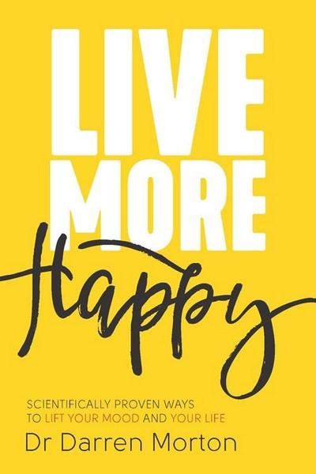
Dr Darren Morton
“Australian researchers found that a Mediterranean-style diet, which emphasised fruits, vegetables, grains and legumes, relieved depression four times more effectively than when only social support was offered to the study participants. More recently, studies have found that a higher consumption of fruit and vegetables not only improves happiness, but also enhances other mental measures like curiosity and creativity.”
BMC Medicine, 15, p.23

Slide 26

Live long. Die short.

Slide 27
Every meal either heals or harms.
All that we consume with our mouth,
ears and eyes has an impact.

Slide 28
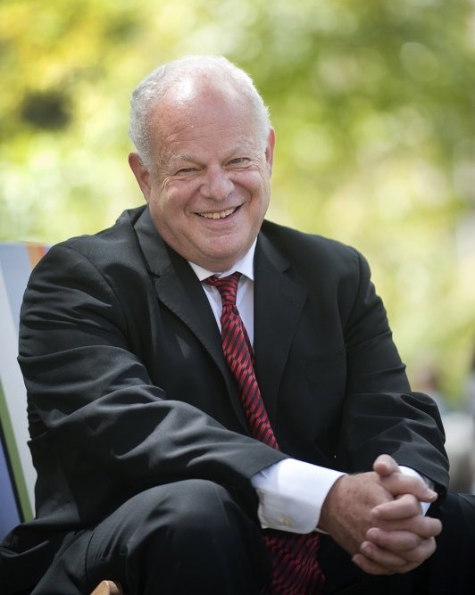
“At least half of positive psychology occurs below the neck.”
Dr Martin Seligman
American Psychological Association

Slide 29
“The pleasure of doing good to others imparts a glow to the feelings which flashes through the nerves, quickens the circulation of the blood, and induces mental and physical health.”
Ellen G. White, Testimonies Vol. 4, 56

Slide 30
“We scientists have found that doing a kindness produces the single most reliable momentary increase in well-being of any exercise we have tested... Here is the exercise: find one wholly unexpected kind thing to do tomorrow and just do it. Notice what happens to your mood.”
Dr Martin Seligman
American Psychological Association

Slide 31
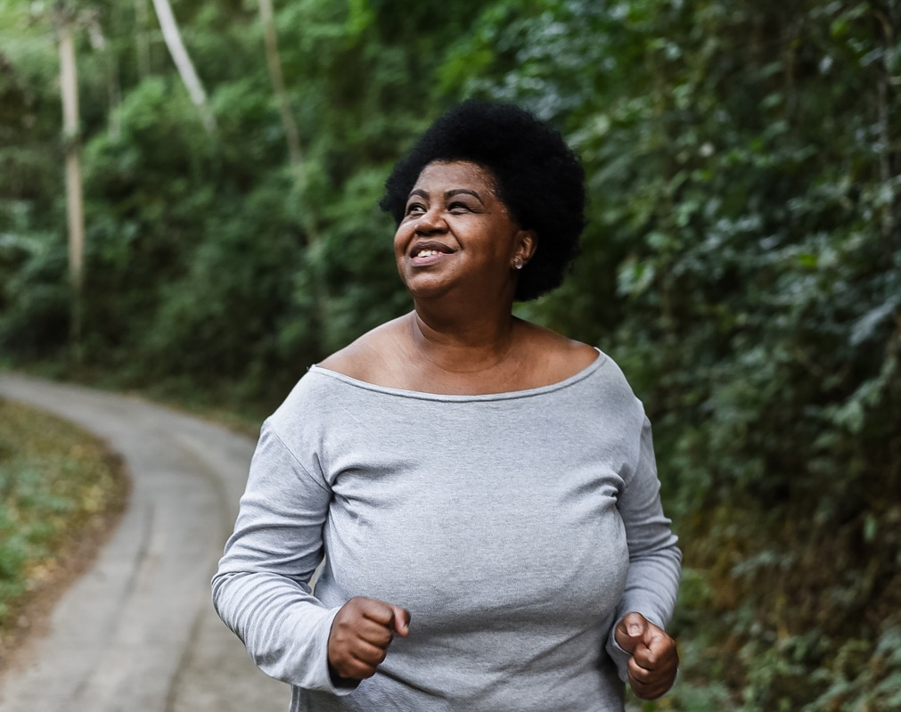
Motion creates emotion.

Slide 32

We die from the feet up.
Keep moving!

Slide 33
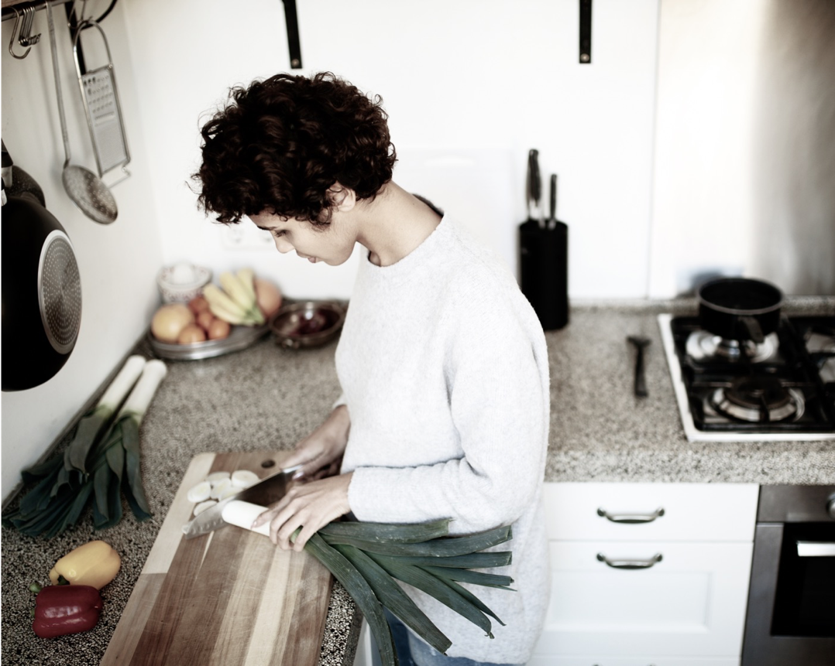
Q. How to be faithful with my Temple?
A. A faithful steward does what their Master would do if He were present.
See Counsels on Stewardship, p. 113

Slide 34
Grateful living leads to cheerful giving.

