Slide 1
The 8 T’s of Grateful Living
POWERPOINT SLIDES INSTRUCTIONS
(Delete this slide before presenting! ☺)
Check this out.
All the work is done! ☺
These slides are simply a helpful guide to get you started on the 8 T’s of Grateful Living theme. You can add, delete or edit them to suit your personal message.
To insert a New Slide. Select New Slide or Layout and select from the 25 x slide templates.* Then simply insert your own text and images onto the slides.
*If you would like to edit the 25 Master templates or make additional slide templates you will need to do the following: Select View > Master > Slide Master.
You can then duplicate a slide layout and make the changes you want.
When you're done, simply select Close Master View.

Slide 2
Why should we encourage Grateful Living? (Delete this slide before presenting! ☺)
This series of Grateful Living messages falls under the category of what we often call ‘stewardship’—managing the things that God gives us—but for many listeners these messages will open up a whole new way of living abundantly (John 10:10).
You see, it’s simple, yet profound. God is love, and because he loves he gives (see John 3:16). God calls us to be faithful stewards of His love by loving Him and giving His love to others. We do this by sharing all that we have and are.
The very heart and foundation of stewardship isn’t money, it’s love.
At it’s very essence, Faithful Stewardship = Loving God and people with all we have and are. We are to love God and people with everything, with our 8 T’s—Time, Talents Testimony, Temple, Treasure, Territory, Tribe and God’s Truth.
In the book Counsels on Stewardship by Ellen G. White, the word ‘love’ is used 36 times in just the first 18 pages! Love is the foundation of stewardship.
When we understand God’s love we live gratefully. Grateful Living is about whole-of-life giving. It’s about passing on the things that our loving Provider God gives to us. God gives, so that we can give. “And God is able to make all grace abound to you, so that in all things at all times having all that you need you will abound in every good work.” (2 Corinthians 9:8)
The gospel calls for a whole new way of living, grateful living, and it places love at the centre—not money, investments, security, prestige or comfort. When we love like God loves, “when we love the world as He has loved it, then for us His mission is accomplished. We are fitted for heaven; for we have heaven in our hearts.” (Ellen G. White, The Desire of Ages, p. 641)
So is this 8 Pillars of Grateful Living really a stewardship series? Yes, because grateful living leads to cheerful giving, not only more faithful tithes and generous, systematic offerings, but whole-of-life giving, and that’s what God invites us to experience.
Welcome! to a whole new level of Christ-centred abundant living.

Slide 3
Grateful Living Topic: TIME
Message Overview (Delete this slide before presenting! ☺)
Key Scriptures: Psalm 90:12; Ecclesiastes 3:1; Ephesians 5:15-17
Key EGW Writings: Christ’s Object Lessons, pp. 342-346; Pastoral Ministry pp. 81-82
Goal: Encouraging and inspiring people to dedicate time every day, and even weeks and years of their life, to God and His work.
Interview Idea: Is there an inspiring person in your church or wider community who you can interview (maybe even by phone or Zoom) about glorifying God through effective time management?

Slide 4
The slides for the actual presentation start on slide #5.
(Delete this slide before presenting! ☺)

Slide 6
The 2-minute video called
Grateful Living Overview & Introduction - Low Res
can be inserted here.

Slide 8
Music: Anna Beaden & Kemy Ogendi

Slide 10
A POSSIBLE OPENING STORY (Delete this slide before presenting. ☺)
We Live in Urgent Times.
Economic researcher and futurist Chris Martenson (I don’t know if he’s a Christian or not), has an illustration that reinforces the fact that the actual end of earth’s history could be much nearer than we think.
Imagine we’re in Sydney’s ANZ Stadium for a Grand Final. We arrive early, before midday, and we want to guarantee our seats so we climb to the very top of the stadium seating—right to highest point—and we handcuff ourselves to our seats. At midday we see a guy walk to the middle of the field. We watch as he uses a magic eyedropper to place a single drop of water on the ground—a drop that magically doubles in size every minute.
Question: If the ANZ Stadium were watertight, how long would we have to get out of the stadium so that we didn’t drown?
For minutes we see no obvious increase in water—one drop becomes two, two drops become four, four drops become eight drops etc.
Question: How long do we have?
By 12:44 p.m. there would be just 1.5 metres of water in the stadium, still leaving 93% of the stadium empty.
Question: How long? How much more time do we have? It’s still 93% empty! Just 1.5 metres of water after 44 minutes.
Well, the startling reality is that if we don’t get out of our handcuffs within the next five minutes, our seats at the very top of the stadium will be under water at 12:49 p.m. It is the power of compounding, geometric progression. For 44 minutes we think we have all the time in the world—(2 Peter 3:3-4) “… scoffers will come in the last days, walking according to their own lusts, and saying, “Where is the promise of His coming? For since the fathers fell asleep, all things continue as they were from the beginning …”—but five minutes later, it’s over! Forever.
So it is, Martenson warns, with our planet today. It’s what we call ‘hockey stick graphs’—global trends that for centuries have appeared to be flat-lined with slow, incremental growth: earth’s population; oil usage, water and food consumption; national debt; personal debt, etc.
To outward appearances the stadium has hardly any water in it—plenty of time left to get out. But as the researcher warns, in these opening years of the third millennium earth is facing a “perfect storm.” A perfect storm of critical trends now simultaneously skyrocketing off the graphs: global debt; energy consumption; scarcity of water and food, combined with an almost vertical population growth. We thought we had time to get ready—but time’s nearly up.
Martenson writes about economic and ecological survival—that’s his specialty. Others study nuclear war, climate change and pandemic survival. Just over a century ago, in about 1905, a lady named Ellen White—a lady blessed with the Biblical, spiritual gift of prophecy—passionately wrote about spiritual survival. Under divine inspiration she wrote, “Great changes are soon to take place in our world, and the final movements will be rapid ones” (Testimonies Vol. 9, p. 11) 9/11—that’s an easy reference to remember!
How we manage our TIME is very, very important.

Slide 11
SDA Fundamental Belief #21
“We are God’s stewards, entrusted by Him with time and opportunities, abilities and possessions, and the blessings of the earth and its resources. We are responsible to Him for their proper use. We acknowledge God’s ownership by faithful service to Him and our fellowmen, and by returning tithes and giving offerings for the proclamation of His gospel and the support and growth of His church. Stewardship is a privilege given to us by God for nurture in love and the victory over selfishness and covetousness. The steward rejoices in the blessings that come to others as a result of his faithfulness.” (Gen. 1:26-28; 2:15; 1 Chron. 29:14; Hag. 1:3-11; Mal. 3:8-12; 1 Cor. 9:9-14; Matt. 23:23; 2 Cor. 8:1-15; Rom. 15:26,27.)
Seventh-day Adventists Believe... A Biblical Exposition of Fundamental Doctrines
(Review & Herald, 2005 ed.)

Slide 12
A disciple is someone who in every way is becoming more like Jesus Christ.
How did Jesus faithfully manage His TIME?

Slide 13

The Great Controversy
^
God’s Blueprint
Satan’s Counterfeit
Every moment is a precious gift.
My time is God’s and I will be most blessed if I use it for His glory.
God created the world in six literal, 24-hour days and rested on the 7th.
Busyness can take us away from God.
Earth’s time will soon be finished.
Today is the day of salvation, I mustn’t delay my commitment to God.
I’ve got all the time in the world.
Time is mine. I can use it how I want.
The earth evolved over millions of years, and it will just keep going.
Busyness is the best way to get ahead.
Mankind will find a way to save the planet from total destruction.
There’s no rush, make your eternal choices tomorrow.

Slide 14
Teach us to number our days,
That we may gain a heart of wisdom.
Psalm 90:12 (NKJV)

Slide 15

“Our time belongs to God. Every moment is His, and we are under the most solemn obligation to improve it to His glory. Of no talent He has given will He require a more strict account than of our time.”
Ellen G. White, Christ’s Object Lessons, 342

Slide 16
To everything there is a season,
A time for every purpose under heaven.
Ecclesiastes 3:1 (NKJV)

Slide 17
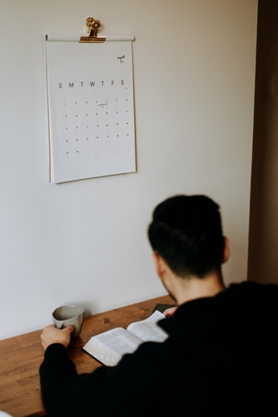
“Time is an entrusted gift of God, and is to be diligently employed in the service of Christ.”
Ellen G. White, Our High Calling, 289

Slide 18
Be still, and know that I am God
Psalm 46:10 (NKJV)

Slide 19
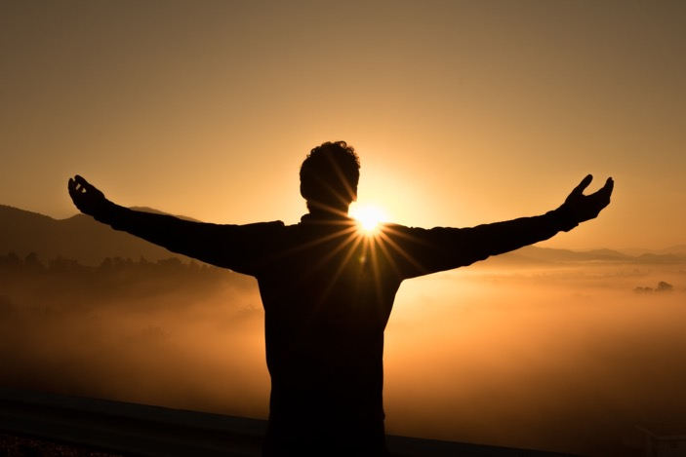
“Day after day we are all to be trained, disciplined and educated for usefulness in this life. Only one day at a time - think of this. One day is mine. I will in this one day do my best.”
Ellen G. White, In Heavenly Places, 227

Slide 20
See then that you walk circumspectly, not as fools but as wise, redeeming the time, because the days are evil. Therefore do not be unwise, but understand what the will of the Lord is.
Ephesians 5:15-17 (NKJV)
“Don’t waste your time on useless work, mere busywork, the barren pursuits of darkness. Expose these things for the sham they are.”
Ephesians 5:15-17 (The Message)

Slide 21
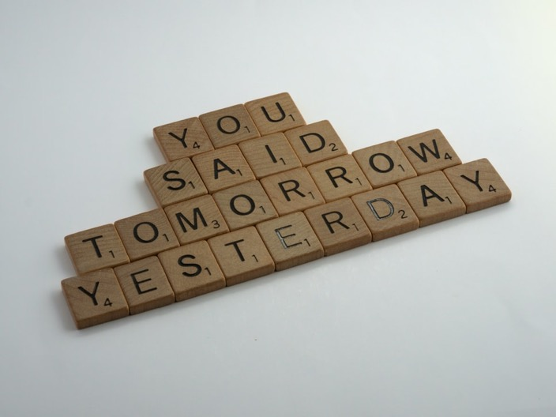
“We are admonished to redeem time. But time squandered can never be recovered. We cannot call back even one moment. The only way in which we can redeem our time is by making the most of that which remains, by being co-workers with God in His great plan of redemption.”
Ellen G. White, Christ’s Object Lessons, 350

Slide 22
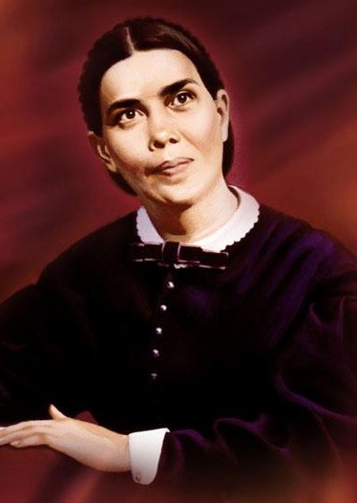
“Our instances are filled with eternal consequences.”
Ellen G. White, Every Day With God, 119

Slide 23
"The stewardship of time is the gearbox of life, as you more effectively manage your time you travel further, faster.”
Luke Farrugia

Slide 24
Robert Banks
on Christian Time Management
“The upshot of this [Christian] commitment to work, community and family is, as my eldest son commented:
‘Christians are like trains—always on the move, always in a rush, and always late.’”
The Tyranny of Time:
When 24 Hours Is Not Enough

Slide 25
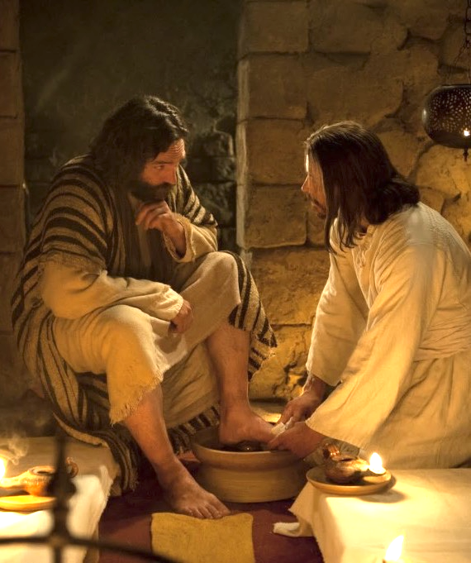
JESUS AND TIME MANAGEMENT
Jesus is our example when it comes to time management.
His time was entirely consecrated to God and to His work.
The gospels don’t portray an image of a stressed-out Jesus, but of One who is limited by time.
His time is dedicated to those who need Him.

Slide 26
The wise use of TIME reflects our PRIORITIES
1. Devotions
2. Sabbath
3. Family
4. Friends
5. Service

Slide 27
DREAM SMALL
Josh Wilson
Singer/Songwriter

Slide 28
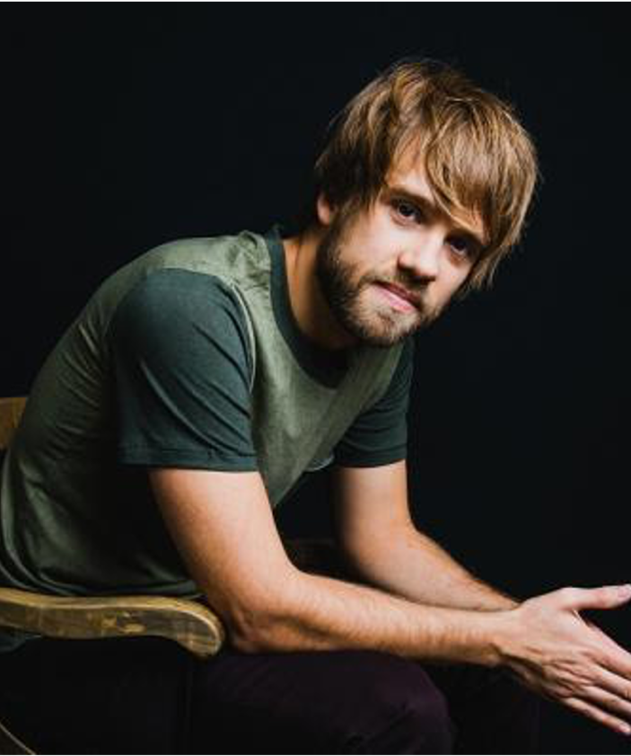
DREAM SMALL by Josh Wilson, Singer/Songwriter
It's a mother singing songs about the Lord.
It's a daddy spending family time, the world says he cannot afford.
These simple moments change the world.
It's a pastor at a tiny little church.
40 years of loving on the broken and the hurt.
These simple moments change the world.
Dream small.
Don't buy the lie you've got to do it all.
Just let Jesus use you where you are.
One day at a time.
Live well. Loving God and others as yourself.
Find little ways where only you can help.
With His great love a tiny rock can make a giant fall.
So dream small.

Slide 29
DREAM SMALL by Josh Wilson, Singer/Songwriter
It's visiting the widow down the street,
Or dancing on a Friday with your friend with special needs.
These simple moments change the world.
Of course there's nothing wrong with bigger dreams,
Just don't miss the minutes on your way to bigger things.
Cause these simple moments change the world. Dream small.
Don't buy the lie you've got to do it all.
Just let Jesus use you where you are.
One day at a time.
Live well. Loving God and others as yourself.
Find little ways where only you can help.
With His great love a tiny rock can make a giant fall. Dream small.

Slide 30

God’s Time Miracle
If we set aside quality time for God every day, he will make us more efficient with the rest of our time, so that we will still accomplish the same amount or more.

Slide 31
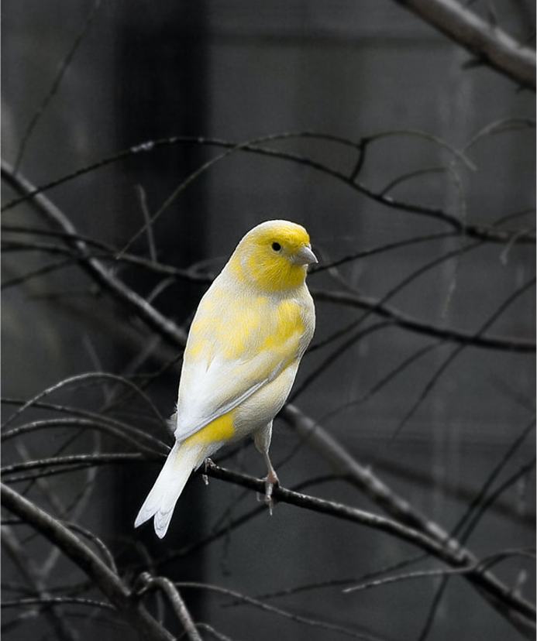
How’s your canary?
Just as the canary in the coal mine notified miners of poisonous gases, a quick look at my calendar notifies me of my life’s true focus. I can profess to be living for noble causes, but my calendar (Time) reveals what I’m actually living for.

Slide 32
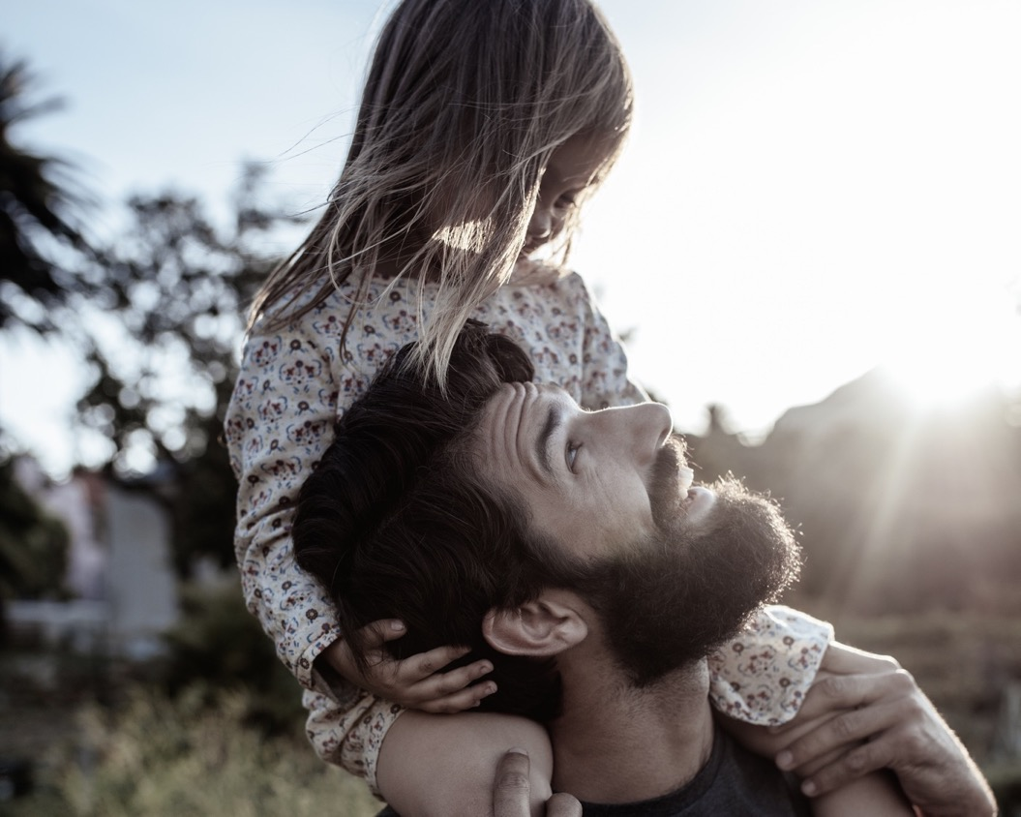
Q. How to be faithful with Time?
A. A faithful steward does what their Master would do if He were present.
See Counsels on Stewardship, p. 113

Slide 33
Grateful living leads to cheerful giving.

