Slide 1
The 8 T’s of Grateful Living
POWERPOINT SLIDES INSTRUCTIONS
(Delete this slide before presenting! ☺)
Check this out.
All the work is done! ☺
These slides are simply a helpful guide to get you started on the 8 T’s of Grateful Living theme. You can add, delete or edit them to suit your personal message.
To insert a New Slide. Select New Slide or Layout and select from the 25 x slide templates.* Then simply insert your own text and images onto the slides.
*If you would like to edit the 25 Master templates or make additional slide templates you will need to do the following: Select View > Master > Slide Master.
You can then duplicate a slide layout and make the changes you want.
When you're done, simply select Close Master View.

Slide 2
Why should we encourage Grateful Living? (Delete this slide before presenting! ☺)
This series of Grateful Living messages falls under the category of what we often call ‘stewardship’—managing the things that God gives us—but for many listeners these messages will open up a whole new way of living abundantly (John 10:10).
You see, it’s simple, yet profound. God is love, and because he loves he gives (see John 3:16). God calls us to be faithful stewards of His love by loving Him and giving His love to others. We do this by sharing all that we have and are.
The very heart and foundation of stewardship isn’t money, it’s love.
At it’s very essence, Faithful Stewardship = Loving God and people with all we have and are. We are to love God and people with everything, with our 8 T’s—Time, Talents Testimony, Temple, Treasure, Territory, Tribe and God’s Truth.
In the book Counsels on Stewardship by Ellen G. White, the word ‘love’ is used 36 times in just the first 18 pages! Love is the foundation of stewardship.
When we understand God’s love we live gratefully. Grateful Living is about whole-of-life giving. It’s about passing on the things that our loving Provider God gives to us. God gives, so that we can give. “And God is able to make all grace abound to you, so that in all things at all times having all that you need you will abound in every good work.” (2 Corinthians 9:8)
The gospel calls for a whole new way of living, grateful living, and it places love at the centre—not money, investments, security, prestige or comfort. When we love like God loves, “when we love the world as He has loved it, then for us His mission is accomplished. We are fitted for heaven; for we have heaven in our hearts.” (Ellen G. White, The Desire of Ages, p. 641)
So is this 8 Pillars of Grateful Living really a stewardship series? Yes, because grateful living leads to cheerful giving, not only more faithful tithes and generous, systematic offerings, but whole-of-life giving, and that’s what God invites us to experience.
Welcome! to a whole new level of Christ-centred abundant living.

Slide 3
Grateful Living Topic: TREASURE
Message Overview (Delete this slide before presenting! ☺)
Key Scriptures: Matthew 6:19-21; Malachi 3:10-12; 2 Corinthians 9:6-8
Key EGW Writings: Counsels of Stewardship (Covers the full spectrum of topics related to managing our material blessings for God’s glory.)
Extra Videos on Tithing: https://disciple.org.au/resources/god-first-tithe-video-series/
Goal: Encouraging and inspiring people to invest their God-given material blessings for God’s kingdom.
Interview Idea: Is there a person in your church or wider community who you can interview (maybe even by phone or Zoom) about investing God’s material blessings in building His kingdom?

Slide 4
The slides for the actual presentation start on slide #5.
(Delete this slide before presenting! ☺)

Slide 6
The 2-minute video called
Grateful Living Overview & Introduction - Low Res
can be inserted here.

Slide 10
SDA Fundamental Belief #21
“We are God’s stewards, entrusted by Him with time and opportunities, abilities and possessions, and the blessings of the earth and its resources. We are responsible to Him for their proper use. We acknowledge God’s ownership by faithful service to Him and our fellowmen, and by returning tithes and giving offerings for the proclamation of His gospel and the support and growth of His church. Stewardship is a privilege given to us by God for nurture in love and the victory over selfishness and covetousness. The steward rejoices in the blessings that come to others as a result of his faithfulness.” (Gen. 1:26-28; 2:15; 1 Chron. 29:14; Hag. 1:3-11; Mal. 3:8-12; 1 Cor. 9:9-14; Matt. 23:23; 2 Cor. 8:1-15; Rom. 15:26,27.)
Seventh-day Adventists Believe... A Biblical Exposition of Fundamental Doctrines
(Review & Herald, 2005 ed.)

Slide 12

The Great Controversy
^
God’s Blueprint
Satan’s Counterfeit
All good gifts, including my income and assets, come from God.
All that I am or can be belongs to God.
God has entrusted me to care for and grow the material gifts He has given me.
Money can very easily become an idol.
I cannot serve God and money.
When I return a faithful 10% tithe and systematic, sacrificial offerings God will bless me, guaranteed.
I work hard for every cent, so I get to choose what to do with it, not God.
My ability to earn money is to be used to increase my comfort and my lifestyle.
God’s word doesn’t give clear advice on where I should return my tithe to.
I can focus all my time and energy on making and spending money as long as I pay tithe.
A dollar is a dollar so God can’t possibly make the 90% go as far, or further, than the 100%.

Slide 13
Lay Up Your Treasures in Heaven
“Do not lay up for yourselves treasures on earth, where moth and rust destroy and where thieves break in and steal; but lay up for yourselves treasures in heaven, where neither moth nor rust destroys and where thieves do not break in and steal. For where your treasure is, there your heart will be also.”
Matthew 6:19-21 (NKJV)

Slide 14
You Cannot Serve God and Money
“No one can serve two masters; for either he will hate the one and love the other, or else he will be loyal to the one and despise the other. You cannot serve God and mammon.”
Matthew 6:24 (NKJV)

Slide 15
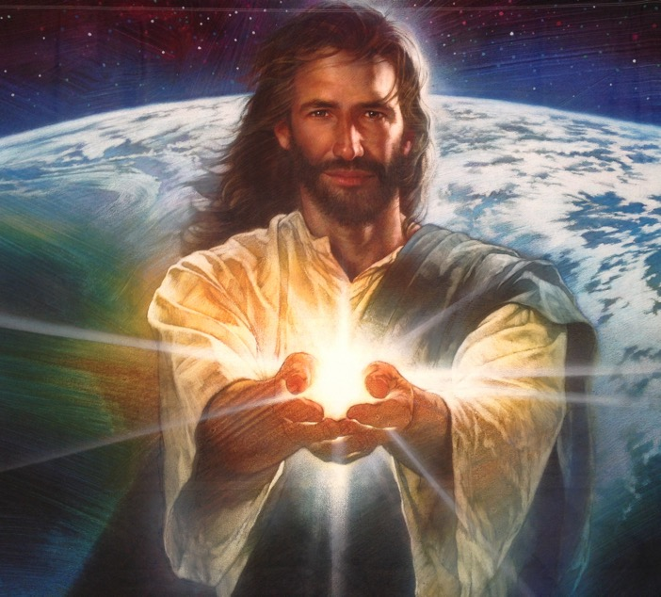
“God gave his Son to draw men back to him. He “so loved the world, that he gave his only begotten Son, that whosoever believeth in him should not perish, but have everlasting life.” He gave all that heaven could give for the saving of the lost. In every soul that receives this love, it will manifest itself in like manner. God so loved that he gave. If we love with his love, we too shall give all.”
Ellen G. White, Review & Herald Feb. 17, 1903

Slide 16
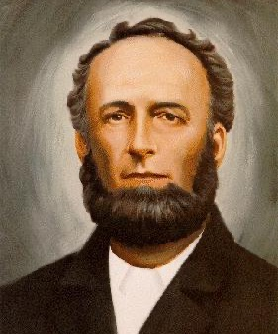
“Giving is a trade, to be learned just as well as any other trade.”
James White, Review & Herald,
Feb. 17, 1903

Slide 17
Gratitude comes first, and generosity is the result.
Generosity is the child of gratitude.

Slide 18
God said to Abraham
“I will make you a great nation; I will bless you and make your name great; and you shall be a blessing. I will bless those who bless you, and I will curse him who curses you; and in you all the families of the earth shall be blessed.”
Genesis 12:2-3 (NKJV)

Slide 19
Blessed to be a blessing.

Slide 20
“And remember the words of the Lord Jesus, that He said, ‘It is more blessed to give than to receive.’ ”
Acts 20:35 (NKJV)

Slide 21
Questions for Contemplation
1. Did Jesus die for the things that I’m living for?
2. If Jesus were living in my neighbour’s house this year, would His calendar and bank statements look like mine?

Slide 22
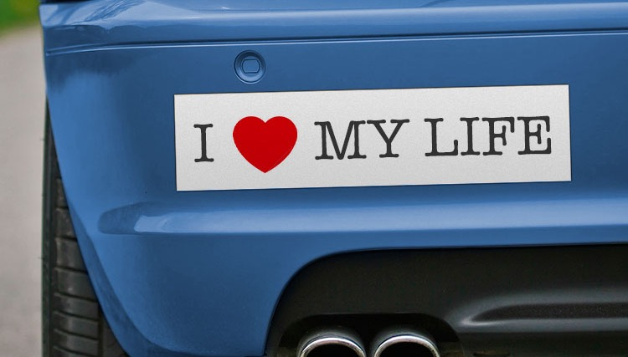
TITHE if you love Jesus.
Anyone can HONK!

Slide 23
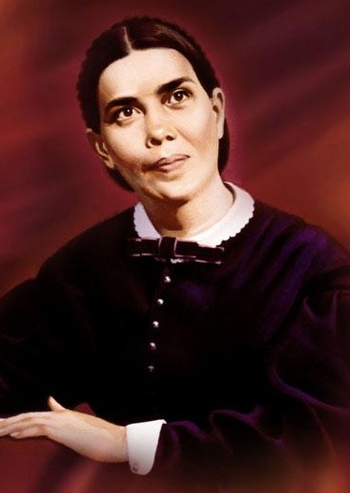
“I saw that God could rain means from heaven to carry on his work, but he never would do this. It is contrary to his plan. He has entrusted men on earth with sufficient means to carry forward his work, and if all do their duty there will be no lack.”
Ellen G. White, Spiritual Gifts, Vol. 2, 267

Slide 24
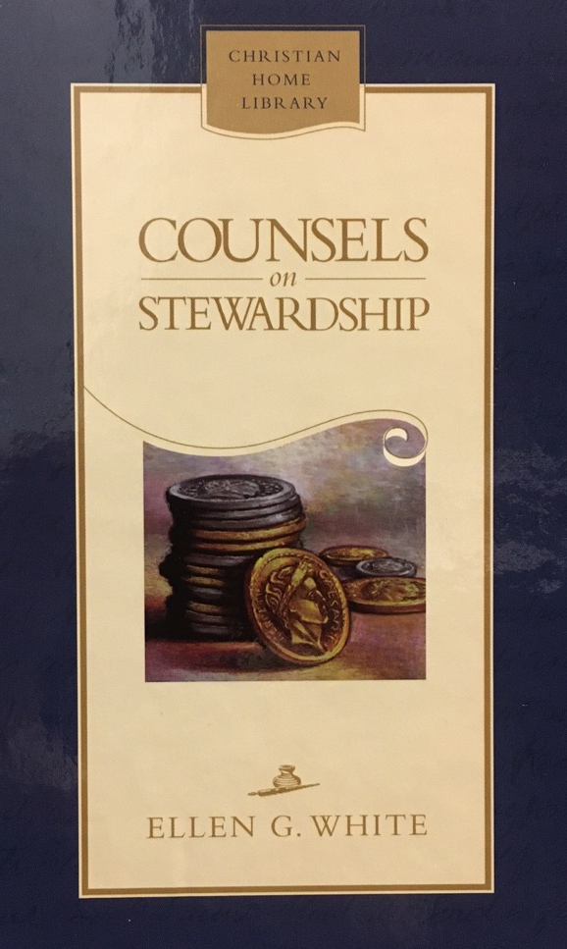
“There are only two places in the universe where we can place our treasures,—in God's storehouse or in Satan's; and all that is not devoted to God's service is counted on Satan's side, and goes to strengthen his cause. The Lord designs that the means entrusted to us shall be used in building up His kingdom. His goods are entrusted to His stewards that they may be carefully traded upon, and bring back a revenue to Him in the saving of souls. These souls in their turn will become stewards of trust, cooperating with Christ to further the interests of God's cause.”
Ellen G. White, Counsels on Stewardship, 35

Slide 25
“Bring all the tithes into the storehouse,
That there may be food in My house,
And try Me now in this,”
Says the Lord of hosts,
“If I will not open for you the windows of heaven
And pour out for you such blessing
That there will not be room enough to receive it.”
Malachi 3:10 (NKJV)

Slide 26
“And I will rebuke the devourer for your sakes, so that he will not destroy the fruit of your ground, nor shall the vine fail to bear fruit for you in the field,” says the Lord of hosts; “And all nations will call you blessed, for you will be a delightful land,” says the Lord of hosts.”
Malachi 3:11, 12 (NKJV)

Slide 27
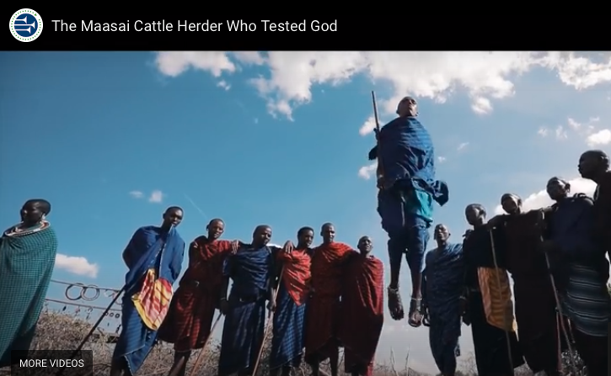
Watch or download the amazing
Maasai Tithing Story video at
https://youtu.be/4VKmsIUhseA

Slide 28
“But this I say: He who sows sparingly will also reap sparingly, and he who sows bountifully will also reap bountifully. So let each one give as he purposes in his heart, not grudgingly or of necessity; for God loves a cheerful giver. And God is able to make all grace abound toward you, that you, always having all sufficiency in all things, may have an abundance for every good work.”
2 Corinthians 9:6-8 (NKJV)

Slide 29
If God is not first with your money,
then he's not first at all.

Slide 30


Slide 31
Possible Closing Story (can be cut and pasted into presenter’s notes) (Delete this slide before presenting! ☺)
Oregon Conference of Seventh-day Adventists - 28 October 2020 - Story by Dick Duerksen
Abundio Reyes is a single, 76-year-old farm labourer. He’s an immigrant who moved to the United States many years ago. He speaks no English and has never attended school. He learnt about God from an Adventist friend who taught him to read by studying a Spanish Bible. Abundio is a faithful member of the Medford Spanish Seventh-day Adventist church in Southern Oregon.
“It’s been hard being a church member this year,” Abundio says. “COVID made it so we couldn’t have services, and I do not have a way to Zoom the videos. But, I have studied and prayed much.”
On Tuesday, September 8, 2020, a small fire started near Abundio’s mobile home. With perfect timing, a 45 mph wind blew up from the southern mountains, fanning the fire like a blowtorch, its swirling flames consuming everything. That blaze, now known as the Alameda Fire, rapidly burned through the communities of Talent and Phoenix.
Abundio lived in Talent, in a mobile home beside Highway 99. The fire took everything he owned – except the clothes he was wearing. His mobile home? Gone. His clothes? Gone. His hat and jacket? Gone. His medicines? Gone.
Church members immediately made a temporary home for him in the church, worked out his medications, brought him bags filled with necessities, and made sure he had a new jacket and more than enough to eat.
“Abundio was,” they said, “very sad.”
A couple days later they had found a small apartment that Abundio and a friend could stay in. That afternoon Abundio found Pastor Cuenca at the church and handed him a fat envelope. “My tithes,” Abundio told Pastor Cuenca. Inside the envelope was $920 in crisp United States cash.
“I have not been able to come to church this year and so have been keeping my tithe in the bank waiting for when I could bring this money to the church. Is it OK to give this to you today?”
“Yes, I have lost everything and have many needs, but I read in the Bible where Jesus says we are to give to God what is His, and my tithe is His holy money. It is not mine.”
“Do not worry Pastor. I belong to God. He will take care of me.”

Slide 32

Q. How to be faithful with Treasure?
A. A faithful steward does what their Master would do if He were present.
See Counsels on Stewardship, p. 113

Slide 33
Grateful living leads to cheerful giving.

Slide 35

Watch or download the
NNSW Tithe Report video at
https://www.youtube.com/watch?v=3ZiEkvtItuI
Extra Resource for North NSW Conference

